Slide 1
Introduction to PHP

Slide 2
Functions
PHP has lots of built-in functions.
The phpinfo() function prints out the internal configuration capabilities of your particular PHP installation
  <?php
  phpinfo();
  ?>

Slide 3
User Defined Functions
Developers can define their own functions If something gets too long or complex ten they can break up it into logical chunks and put those chunks in functions.
Make a library of common stuff that you do over and over.
<?php
function functionName() {
code to be executed;
}
function addFunction($num1, $num2) {
$sum = $num1 + $num2;
echo "Sum of the two numbers is : $sum"; }
addFunction(5, 10); ?>

Slide 4
Functions
Function Calling
<?php
function addnum($num)
{ $num += 6; }
function add(&$num)
{ $num += 6; }
//origional value for variable count will be updated
$count= 10;
add($count);
//origional value for variable count will not be updated
addnum($count);
?>
Dynamic Function Calling
<?php
function welcomeMsg(){
echo "Hello<br />"; }
$function_holder = " welcomeMsg";
$function_holder(); ?>

Slide 5
Advance PHP

Slide 6
PHP Classes
Basic class definitions begin with the keyword class, followed by a class name, followed by a pair of curly braces which enclose the definitions of the properties and methods belonging to the class.
<?php
//Define Class
class Books {
/* Member variables */
var $price;
var $title;
/* Member functions */
function setPrice($par){
// keyword this refers to the same object
$this->price = $par;}
function getPrice(){
echo $this->price."<br/>";
}}
//Create Object for Class
$physics = new Books();
//Call member functions
$physics-> setPrice( “£10" );
$physics->getPrice();
?>

Slide 7
PHP Classes: Constructor
<?php
class Fruit {
public $name;
public $color;
function __construct($name) {
$this->name = $name;
}
function get_name() {
return $this->name;
}
}
$apple = new Fruit("Apple");
echo $apple->get_name();
?>
function __construct($name) {
$this->name = $name;
}

Slide 8
Inheritance
With Inheritence child class automatically gets all the member variable declarations of the parent class.
Gets automatically all the member functions as the parent, which (by default) will work the same way as those functions do in the parent.
class Novel extends Books {
var $publisher;
function setPublisher($par){
$this->publisher = $par; }
function getPublisher(){
echo $this->publisher. "<br />";
} }

Slide 9
Visibility
Public Members
Private Members
Protected Members
<?php
class MyClass
{ public $public = 'Public';
protected $protected = 'Protected';
private $private = 'Private';
function printHello()
{
echo $this->public;
echo $this->protected;
echo $this->private;
}
}
$obj = new MyClass();
echo $obj->public; // Works
echo $obj->protected; // Fatal Error
echo $obj->private; // Fatal Error
$obj->printHello();// Shows Public,
//Protected and Private
?>

Slide 10
PHP Date() Function
The date/time functions allow you to get the date and time from the server where your PHP script runs. You can then use the date/time functions to format the date and time in several ways
The PHP date() function formats a timestamp to a more readable date and time.
  d - Represents the day of the month (01 to 31)‏
  m - Represents a month (01 to 12)‏
  Y - Represents a year (in four digits)‏
  <?php
  // set the default timezone to use. Available
  since PHP 5.1. see List of Supported Timezones at php.net
  date_default_timezone_set('Asia/Karachi');
  // Prints something like: Monday
  echo date("l");
  // Prints something like: Monday 8th of August 2005 03:12:46 PM
  echo date('l jS \of F Y h:i:s A');
  // Prints: July 1, 2000 is on a Saturday
  echo "July 1, 2000 is on a " . date("l", mktime(0, 0, 0, 7, 1, 2000));
  ?>
  date(format,timestamp);
format- Specifies the format of the outputted date string.
timestamp- Optional. Specifies an integer Unix timestamp. Default is the current local time (time())

Slide 11
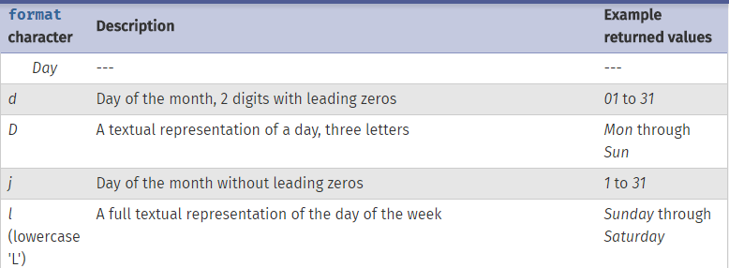
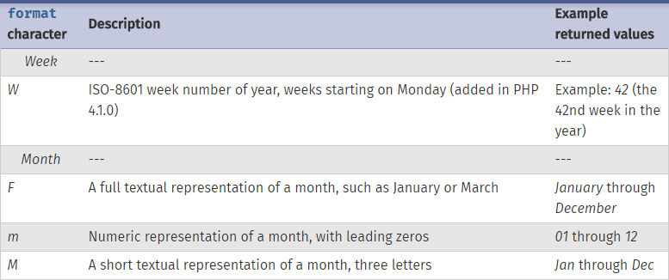
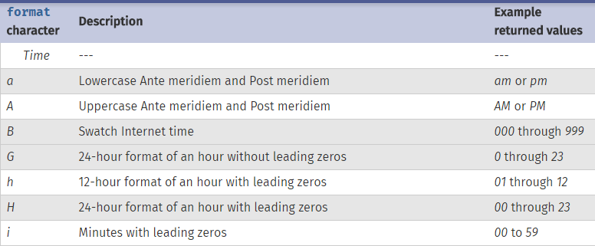

Slide 12
DateTime Class
DateTime::add — Adds an amount of days, months, years, hours, minutes and seconds to a DateTime object
DateTime::construct — Returns new DateTime object
DateTime::createFromFormat — Parses a time string according to a specified format
DateTime::getLastErrors — Returns the warnings and errors
DateTime::modify — Alters the timestamp
DateTime::setDate — Sets the date
DateTime::setISODate — Sets the ISO date
DateTime::setTime — Sets the time
DateTime::setTimestamp — Sets the date and time based on an Unix timestamp
DateTime::setTimezone — Sets the time zone for the DateTime object
DateTime::sub — Subtracts an amount of days, months, years, hours, minutes and seconds from a DateTime object

Slide 13
PHP include,require
The include() function takes all the content in a specified file and includes it in the current file.
The require() function is identical to include(), except that it handles errors differently. Its is used to include the file with critical functionality
If an error occurs, the include() function generates a warning, but the script will continue execution. The require() generates a fatal error, and the script will stop.
require_once() statement can be used to include a php file in another one. If it is found that the file has already been included, calling script is going to ignore further. For example add file that displays date.
  <html>
  <body>
  <h1>Welcome to CIIT<h1>
  <?php require ‘header.php';
  <?php include ‘footer.php';
  ?>
  </body>
  </html>

Slide 14
PHP File Handling
Opening a File
  The fopen() function is used to open files in PHP.
Three different modes are available
Here's the list:
'r' - opens a file in read mode
'w' - opens a file in write mode,
destroying existing file contents
'a' - opens a file in append mode,
preserving existing file contents
<?php
// set file to read
$file = ‘welcome.txt' or die('Could not open file!');
// open file
$fh = fopen($file, 'r') or die('Could not open file!');
// read file contents
$data = fread($fh, filesize($file)) or die('Could not read file!');
// close file
fclose($fh);
// print file contents
echo $data;
?>

Slide 15
Example
<?php
// set file to write
$file = 'dump.txt';
// open file
$fh = fopen($file, 'w') or die('Could not open file!');
// write to file
fwrite($fh, “This is first php file! ") or die('Could not write to file');
// close file
fclose($fh);
?>

Slide 16
Functions
PHP also comes with a bunch of functions that allow you to test the status of a file - for example to find out whether it exists, whether it's empty, whether it's readable or writable, and whether it's a binary or text file.
is_dir() - returns a Boolean indicating whether the specified path is a directory
is_file() - returns a Boolean indicating whether the specified file is a regular file
is_executable() - returns a Boolean indicating whether the specified file is executable
is_readable()- returns a Boolean indicating whether the specified file is readable
is_writable()- returns a Boolean indicating whether the specified file is writable
filesize() - gets size of file
filemtime() - gets last modification time of file
filamtime() - gets last access time of file
fileowner() - gets file owner
fileperms() - gets file permissions
filetype() - gets file type

Slide 17
PHP File Uploading
A PHP script can be used with a HTML form to allow users to upload files to the server.
Initially files are uploaded into a temporary directory and then relocated to a target destination by a PHP script.
There is one global PHP variable called $_FILES.
This variable is an associate double dimension array and keeps all the information related to uploaded file. So if the value assigned to the input's name attribute in uploading file, then PHP would create following five variables −
$_FILES['file']['tmp_name'] − the uploaded file in the temporary directory on the web server.
$_FILES['file']['name'] − the actual name of the uploaded file.
$_FILES['file']['size'] − the size in bytes of the uploaded file.
$_FILES['file']['type'] − the MIME type of the uploaded file.
$_FILES['file']['error'] − the error code associated with this file upload.
form was destination by a PHP script.

Slide 18
PHP File Uploading
No Characters are encoded
<html>
<body>
<form action="Upload.php" method="POST" enctype="multipart/form-data">
<input type=“text” name=“title” >
<input type="file" name="image" />
<input type="submit"/>
</form>
</body>
</html>

Slide 19
PHP File Uploading
<?php
if(isset($_FILES['image'])){
$errors= array();
$file_name= $_FILES['image']['name'];
$file_size = $_FILES['image']['size'];
$file_tmp = $_FILES['image']['tmp_name'];
$file_type = $_FILES['image']['type'];
$file_ext=strtolower(end(explode('.',$_FILES['image']['name'])));
$extensions= array("jpeg","jpg","png");
if(in_array($file_ext,$extensions)=== false){
$errors[]="extension not allowed, please choose a JPEG or PNG file.";}
if($file_size > 2097152) {
$errors[]='File size must be excately 2 MB';}
if(empty($errors)==true) {
move_uploaded_file($file_tmp,"images/".$file_name);
echo "Success <br/>";}
else{print_r($errors);}
//Explore the values returned by explode function
var_dump(explode('.',$_FILES['image']['name']));
}?>

Slide 20
MYSQL Connection
<?php
$servername = "localhost";
$username = "root";
$password = ‘’;
$dbname = "data";
$con = mysqli_connect($servername, $username, $password, $dbname)
or die ('Could not connect to the database server' . mysqli_connect_error());
$con->close();
?>

Slide 21
MYSQL Connection
$servername = "localhost";
$username = "root";
$password = "";
$dbname = "bcs";
$con = mysqli_connect($servername, $username, $password, $dbname);
if(!$con) {
die('Could not connect: ' . mysql_error());
}
echo 'Connected successfully';

Slide 22
PHP MySql
Create Table
<?php
$sql = "CREATE TABLE MyStudent( “.
"student_Id INT NOT NULL AUTO_INCREMENT, ".
"student_Name VARCHAR(100) NOT NULL, ".
"student_Email VARCHAR(40) NOT NULL, ".
"PRIMARY KEY ( student_id )); ";
if ($con->query($sql) === TRUE) {
echo "Table MyStudent created successfully";
}
else {
echo "Error creating table: " . $con->error;
}
?>
//PHP Connection with MYSQL
<?php
$servername = "localhost";
$username = "root";
$password = ‘’;
$dbname = "data";
$con = mysqli_connect($servername, $username, $password, $dbname)
or die ('Could not connect to the database server' . mysqli_connect_error());
?>

Slide 23
Insert, Select
<? php
//Insert Values into table
$sql = "INSERT INTO MyStudent(student_Name, student_Email)
VALUES ('Doe', 'john@example.com')";
$result = $con->query($sql);
//Select values from table
$sql = "SELECT firstname, lastname FROM student;";
$result = $con->query($sql);
if ($result->num_rows > 0) {
// output data of each row
while($row = $result->fetch_assoc()) {
echo " - Name: " . $row["firstname"]. " " . $row["lastname"]. "<br>";
}
} else {
echo “No results found";
}
?>

Slide 24
Naming Conventions for Database
Student_Data, studentData
Tables Names
  Student_Courses, studentCourses
Table Fields
Student_Id, Student_Name
studentId, studentName

